Slide 1

Stop Hoping for a Raise &
Start Engineering One
Kristyna Ferris
Fun Fact: this font is dyslexic friendly! Ask me how to use it for free after the session.
Notes:
Open-Dyslexic Font | dafont.com
Download the font from Open-Dyslexic Font | dafont.com
Extract the files
Go to computer settings > personalization > fonts and drop in the files
Navigate to Power Point Master Slide
Change the font to use Open Dyslexic for the headers and body
Done!

Slide 2

About Me ~ Kristyna Ferris
Microsoft MVP, Data Platform & Fabric
Solution Architect, P3 Adaptive
Lexington Data Tech Group co-organizer
DataOnWheels Author
Blog
https://dataonwheels.wordpress.com/
LinkedIn
https://www.linkedin.com/in/kristyna-ferris-dataonwheels/
Twitter & Bluesky
@data_dragoness

Slide 3
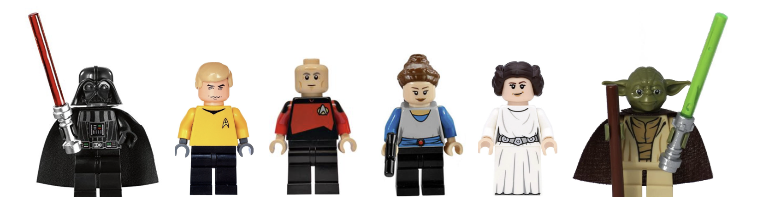
Agenda
First Impressions – Assign your Boss to a Character
Assess, Learn, and React Well to Each Boss Type
Darth Vader
Captain Picard
Queen/Senator Padme
Princess Leia
Captain Kirk
Yoda
Second Impressions – Anyone Change their Assessment?
The Battle Before the Battle
When to Walk Away from a Job
Notes:
What are the 4 Most Common Leadership Styles?
Goleman’s Situational Leadership Styles Framework – Disruptive Leadership Institute

Slide 4

A Long Time Ago, in a Salary Far, Far Away…
Raise your hand if you have ever walked into a raise conversation feeling like you were entering the trash compactor scene.
Walls closing in.
No plan.
Only there because you had no other choice.
Notes:
What are the 4 Most Common Leadership Styles?
Goleman’s Situational Leadership Styles Framework – Disruptive Leadership Institute

Slide 5

A Long Time Ago, in a Salary Far, Far Away…
Keep your hand raised if
the response from your boss was so bad that you eventually pulled a Han Solo and left for a cause that paid better.
Notes:
What are the 4 Most Common Leadership Styles?
Goleman’s Situational Leadership Styles Framework – Disruptive Leadership Institute

Slide 6

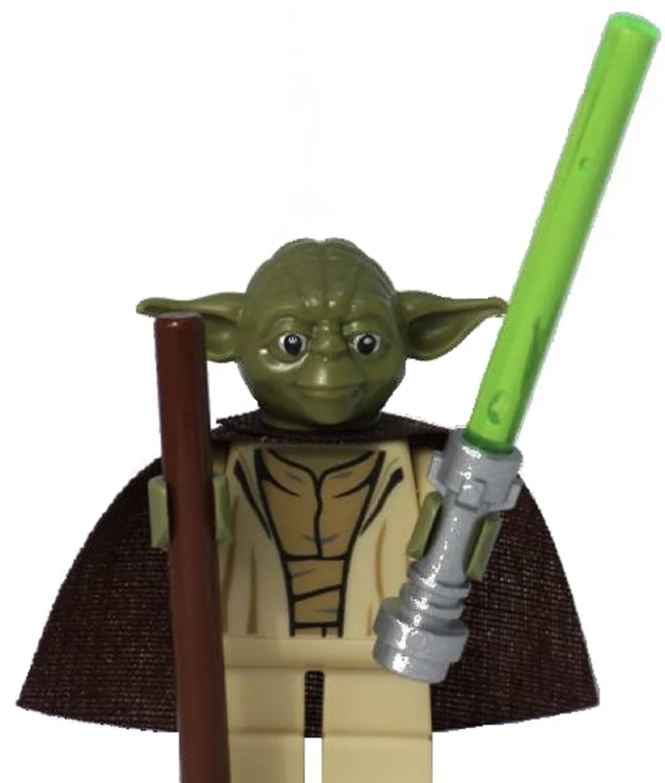
Right Case, Wrong Audience
Notes:
So here is the thing. Most of the time when that conversation goes sideways, it is not because you did not deserve the raise. It is because you walked in with the right case and delivered it to the wrong audience. You gave a Yoda boss a Vader pitch. You brought feelings to a Palpatine. You tried to have a collaborative dialogue with someone who just wanted a number and a reason.

Slide 7
So, who is YOUR Boss? Really?
Notes:
The pivot:
So before we talk about how to build your case, we need to talk about who you are building it for. Because the same case delivered six different ways gets six different results.
I am going to walk you through six boss types. Each one is mapped to a character you already know. As I describe them, I want you to start thinking about your boss. Not who you wish they were. Who they actually are. How do they run meetings? How do they deliver bad news? Do they want details or just the answer? Do they ask for your opinion or have they already decided before you sit down?
By the time I am done, I want you to commit to one. Pick the character that makes you say 'oh no, that is absolutely my boss.' We are going to come back to that choice later, so do not overthink it. Go with your gut.

Slide 8
Darth Vader (Coercive/Commanding)
How to Pitch the Dark Side
This is a business transaction, not a conversation. Feelings will get you force choked.
The pitch:
Lead with numbers. Revenue impact, cost savings, market data. Nothing else.
Have a specific number ready. Vader does not want to workshop this with you.
Be direct, be brief, and be confident. If you ramble, you lose them.
Frame it as ROI, not a request. "Here is what I have delivered. Here is what the market says that is worth."

Slide 9
Darth Vader (Coercive/Commanding)
Is Your Boss a Sith Lord?
This boss leads with "do what I tell you." They value compliance, chain of command, and results delivered on time with no excuses.
How to spot them:
Decisions come from the top. Your input was not requested.
Meetings are short. There is no brainstorming. There is a directive.
They thrive in a crisis because they are built for command and control.
"Why" is not a question they entertain. "When will it be done" is.
Feedback sounds a lot like orders.
They are effective when the building is on fire. The problem is they lead like the building is always on fire.

Slide 10
Darth Vader (Coercive/Commanding)
Surviving the Force Choke
Vader said no. You are still alive. That is actually a good sign.
Do not get emotional. Do not argue. Accept the answer in the moment.
Then ask one question: "What targets would change this conversation next quarter?"
Vader respects someone who takes a no and immediately pivots to the next mission.
Get the answer in writing. Send a follow-up email summarizing what was discussed and what the benchmarks are.
If Vader cannot give you a clear target, that is your signal. It is not "not yet." It might be "not ever."
If you hit the targets and the answer is still no the second time around, it is time to find a new ship.

Slide 11
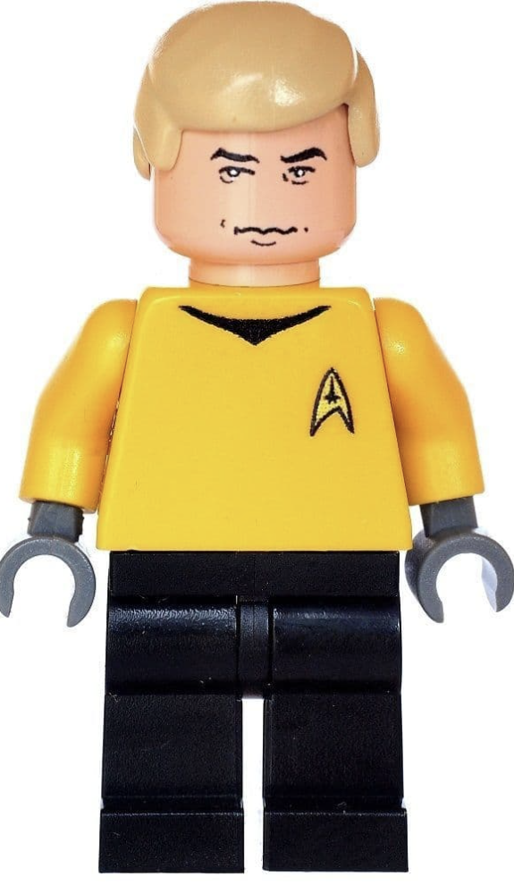
Captain Kirk (Pacesetting)
Is Your Boss the Captain of the Enterprise?
This boss leads by example and expects you to keep up. They set the bar high and have little patience for anyone who cannot match their pace.
How to spot them:
They are the first one in and the last one out. And they notice if you are not.
They do not delegate much because they think they can do it faster themselves.
They expect excellence as the baseline, not the goal.
Feedback is rare. If you are not hearing anything, that might actually mean you are doing fine.
They thrive on momentum. Slow down and you become invisible.
They are great at driving results. They are not great at noticing the team is running on fumes.

Slide 12
Captain Kirk (Pacesetting)
How to Keep Up with Kirk
Kirk is not impressed by what you could do. Kirk is impressed by what you already did.
Do not talk about potential. Talk about performance. Bring the scoreboard.
Show initiative you took without being asked. Kirk loves a self-starter.
Highlight where you exceeded expectations, not just met them.
Frame the raise as recognition of a standard you are already sustaining, not a reward for showing up.
Be specific. Projects delivered, problems solved, fires put out before they spread.
Match their energy in the room. Confidence matters. If you undersell yourself, Kirk will believe you.

Slide 13
Captain Kirk (Pacesetting)
There Is No No-Win Scenario
Kirk said no. That just means you have not rewritten the test yet.
Ask what "enough" looks like in specific, measurable terms. Pin them down.
Kirk respects persistence, not complaining. Come back with bigger results, not a bigger argument.
Do not wait for them to revisit the conversation. Set a date and hold them to it.
In the meantime, find a visible win. Something with impact that Kirk cannot ignore.
If you hit every target and the answer is still no, remember that Kirk would not stay on a ship that did not value him either.

Slide 14

Captain Picard (Authoritative/Visionary)
Is Your Boss Running a Starship or Mission?
This boss leads with vision. They are always pointing the crew toward something bigger than the task in front of them.
How to spot them:
They talk about where the team is going more than what the team is doing today.
They connect even small projects back to a larger purpose or strategy.
They give you freedom on the "how" as long as you understand the "why."
They are inspiring in all-hands meetings but might leave you fuzzy on the details.
They want people who believe in the mission, not just people who complete the tasks.
They are great at rallying the crew. Sometimes less great at telling you exactly what they need by Friday.

Slide 15
Captain Picard (Authoritative/Visionary)
Getting Picard to Say 'Engage’”
Picard does not want to hear about your salary. Picard wants to hear about your mission.
Connect your case to their vision. Show how investing in you accelerates where they want to take the team.
Use their language. If they talk about growth, innovation, or long-term strategy, your pitch should too.
Frame your contributions as advancing the mission, not just completing assignments.
Show that you understand the bigger picture and that you are asking to take on a bigger role in it.
Do not make it transactional. Make it aspirational. "Here is where I see myself contributing next."
Picard will invest in someone who is bought in. Make sure that comes through.

Slide 16
Captain Picard (Authoritative/Visionary)
When the Captain Says 'Not Yet’
Picard said no. But Picard almost always tells you why. Listen carefully.
The reason behind the no is your roadmap. They just told you where you do not yet fit in the bigger picture.
Ask how your growth aligns with where the team is headed. Let them paint the path.
Do not take it personally. Picard separates the person from the decision. You should too.
Follow up with something that shows you heard them. Pick up a project that maps to what they said was missing.
If Picard keeps saying no but cannot connect it to the vision, the vision might not include you. That is worth paying attention to.

Slide 17
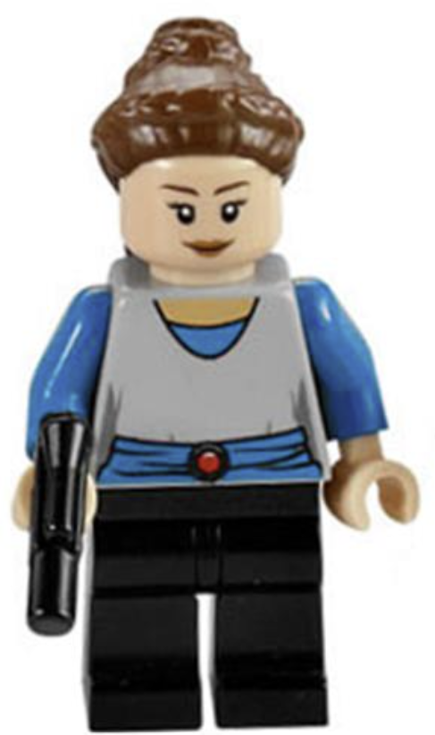
Queen/Senator Padme (Affiliative)
Is Your Boss Leading with Heart?
This boss leads with relationships and emotional bonds. They want the team to feel like a family, and they mean it.
How to spot them:
They check in on you as a person, not just your project status.
Team harmony matters more to them than almost anything else.
They remember your birthday, ask about your kids, and notice when something is off.
Conflict makes them uncomfortable. They would rather smooth things over than have it out.
They are the first person to defend you to someone else and the last person to give you tough feedback directly.
They are wonderful when morale is low. They struggle when someone needs to be held accountable.

Slide 18
Queen/Senator Padme (Affiliative)
Diplomacy, Not Demands
Padme does not respond to ultimatums. She responds to trust.
Lead with the relationship. Acknowledge what they have done for you and the team.
Express your loyalty and your long-term commitment before you bring up numbers.
Ease into the data. Do not open with a spreadsheet. Open with a conversation.
Frame it as a natural next step, not a disruption. "I love being here. I want to make sure I can keep being here."
Do not mention other offers or threaten to leave. To Padme, that feels like betrayal.
Let them feel like supporting your raise is something they want to do, not something they are being pressured into.

Slide 19
Queen/Senator Padme (Affiliative)
Keeping the Alliance Intact
Padme said no. She probably feels worse about it than you do.
Do not punish them emotionally. They are already carrying the weight of the decision.
Acknowledge that you understand and ask to build a plan together. "Can we figure out what gets us there?"
Keep the relationship warm. Going cold after a no will confirm their fear that the ask was transactional.
Give them time. Padme needs to process and may come back with something on her own.
If the answer stays no and they cannot give you a path forward, pay attention to whether the relationship is a substitute for actual investment in your career. Loyalty is wonderful, but it does not pay your mortgage.

Slide 20
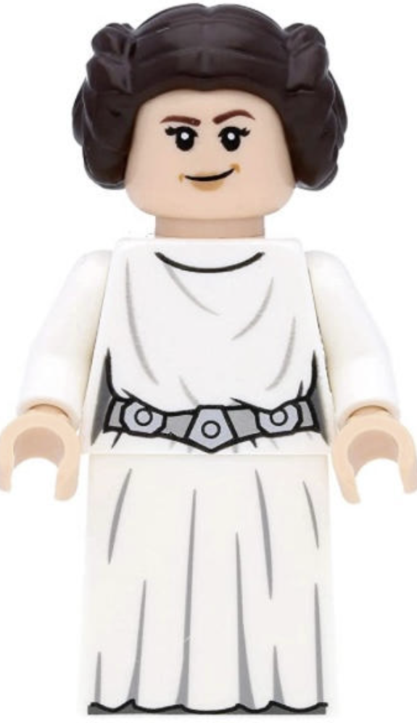
Princess Leia (Democratic)
Is Your Boss Running a Rebellion by Committee?
This boss leads by gathering input. They want every voice at the table before they make a call.
How to spot them:
They ask what does everyone think? before making almost any decision.
Meetings run long because everyone gets a turn to weigh in.
They genuinely value diverse perspectives and get energized by debate.
They are slow to decide but once they do, the whole team is usually on board.
They want buy-in, not just compliance. Consensus matters to them.
They are great at building team ownership. They are less great when something needs to happen right now.

Slide 21
Princess Leia (Democratic)
Getting the Council to Vote Your Way
Leia does not want to be told what the answer is. She wants to help figure it out.
Share your research, your market data, and your contributions. Then ask, What do you think is fair?
Invite them into the decision. Let them feel ownership over the outcome.
Do not present an ultimatum or a fixed number. Present a case and open a dialogue.
Be ready for follow-up questions. Leia is going to want to think it through from multiple angles.
If they have peers or leaders they collaborate with, your case needs to hold up to that audience too.
The more you make this feel like a joint decision, the more likely you are to get a yes.

Slide 22
Princess Leia (Democratic)
When the Rebellion Says 'Not Now’
Leia said no. But she probably wants to keep talking about it.
Let her. Ask what factors she is weighing. You might discover the obstacle has nothing to do with you.
Budget constraints, team equity, timing, politics above her head. Leia will tell you if you give her space to.
Ask who else needs to be involved in the decision. There might be a coalition you need to build.
Do not go quiet. Leia reads silence as disengagement, and she values people who stay in the conversation.
If Leia keeps gathering input and never lands on a decision, that is its own answer. At some point the committee is just a way to avoid saying no directly.

Slide 23
Yoda (Coaching)
Is Your Boss a Jedi Master?
This boss leads by investing in your growth. Every conversation is a chance to teach you something.
How to spot them:
They answer your questions with more questions.
They care more about how you got to the answer than the answer itself.
They give feedback constantly, and it is usually framed as a development opportunity.
They talk about your career trajectory more than your current deliverables.
They are patient with mistakes as long as you learned something from them.
They are incredible for your long-term growth. They can be frustrating when you just need a straight answer.

Slide 24
Yoda (Coaching)
Earning Your Next Rank
Yoda does not hand out promotions. Yoda hands out lessons. The promotion is what happens when you pass them.
Frame the raise as part of your development journey, not a standalone ask.
Show where you have grown, what skills you have built, and where you are headed next.
Ask the question in their language. Given my growth trajectory, what would it take to get to the next level?
Let them coach you toward the answer. They want to feel like they helped you get there.
Connect your development to the team's needs. Show that your growth is not just personal. It makes the whole crew better.
Do not skip the conversation and jump straight to a number. That is like telling Yoda you want to skip training and go straight to the lightsaber fight.

Slide 25
Yoda (Coaching)
Patience, Young Padawan
Yoda said no. But Yoda always has a reason, and it is almost always a lesson.
Lean into it. Ask what skills or milestones would make this a different conversation.
Yoda will literally coach you to the raise if you let them. That is not a no. That is a syllabus.
Take notes. Whatever they tell you, write it down and bring it back next time as proof you listened.
Set a timeline together. If I accomplish these things in the next six months, can we revisit?
If Yoda keeps moving the goalposts and the lessons never lead to a result, the training might be the point for them, not your advancement. A good mentor wants you to graduate eventually.

Slide 26
Second Impressions: Did You Change Your Mind?
Notes:
At the beginning I asked you to pick a character for your boss. Go with your gut, I said. So now that you have seen all six up close, how many of you are rethinking that choice?
Good. That means the framework is working. Because most people walk into a raise conversation with an assumption about who their boss is based on how they feel about them, not how their boss actually operates. You might like your boss and assume they are a Padme. But then you realize they actually run everything by committee and you have been dealing with a Leia the whole time. Or you think you have a Vader because they are intense, but they are actually a Kirk. They are not controlling. They just expect you to keep up.
Getting this wrong is exactly how the right case gets delivered the wrong way. So if your character changed, your entire playbook just changed too. And now you know that before you walk into the room instead of figuring it out the hard way.

Slide 27
Second Impressions: Did You Change Your Mind?
Intense is not the same as commanding. That might Kirk driving pace, not Vader giving orders.
Supportive is not collaborative. That might be Padme protecting harmony, not Leia seeking input
Asking questions does not mean coaching. That might be Leia getting input, not Yoda developing you.
Inspiring is not the same as being warm. That might be Picard casting vision, not Padme building bonds.
Get the character right and the playbook follows.
Notes:
At the beginning I asked you to pick a character for your boss. Go with your gut, I said. So now that you have seen all six up close, how many of you are rethinking that choice?
Good. That means the framework is working. Because most people walk into a raise conversation with an assumption about who their boss is based on how they feel about them, not how their boss actually operates. You might like your boss and assume they are a Padme. But then you realize they actually run everything by committee and you have been dealing with a Leia the whole time. Or you think you have a Vader because they are intense, but they are actually a Kirk. They are not controlling. They just expect you to keep up.
Getting this wrong is exactly how the right case gets delivered the wrong way. So if your character changed, your entire playbook just changed too. And now you know that before you walk into the room instead of figuring it out the hard way.

Slide 28

The Battle Before the Battle
The raise is not won in the meeting.
It’s won in the months before the meeting.
Know your “make money button”
Build your case before you need it
Seed your value so the ask is not a surprise
Know your number before you walk in
Notes:
Know your "make money button"
Every company hired you because you help them make or save money somehow. Figure out what that is.
If you cannot explain how your work connects to revenue, cost savings, or keeping a critical function running, you do not have a case yet.
Ask yourself: if I disappeared tomorrow, what would break? That is your leverage.
Build your case before you need it
Track your wins in real time. Do not try to remember six months of impact the night before your meeting.
Save the emails where someone thanked you for solving a problem. Screenshot the metrics that moved.
Keep a running document. Even just bullet points in a notes app. Future you will be grateful.
Seed your value so the ask is not a surprise
Your boss should already know what you have contributed before you sit down.
Mention wins naturally in 1:1s and stand-ups. Not bragging. Just reporting.
If you helped another team, make sure your boss heard about it. Not from you begging for credit. From the work being visible.
Know your number before you walk in
Research the market. Glassdoor, Levels.fyi, Payscale, recruiter conversations, peers in your network.
Have a specific number or range ready. "I would like more money" is not a pitch. It is a wish.
Know the difference between what the market pays and what you can justify based on your impact. Ideally those overlap.

Slide 29
The Battle Before the Battle
Pitching Vader? Make sure 1:1s have been tight and results-focused for months
Pitching Kirk? Your recent performance should already be speaking for itself.
Pitching Picard? Start connecting your work to the team vision well before the ask.
Pitching Padme? Invest in the relationship. The trust has to be there first.
Pitching Leia? Make sure your contributions are visible to the broader team, not just your boss.
Pitching Yoda? Turn your regular check-ins into growth conversations so the raise feels like a natural milestone.

Slide 30
When to Fly the Falcon to a New System
A "no" is data. Multiple "no"s are a pattern.
One no is a conversation. It means "not yet" or "show me more.“
Two nos with clear feedback is a process. You are still on a path.
Three nos with shifting goalposts or vague reasons is an answer. The organization cannot or will not pay you what you are worth.

Slide 31
When to Fly the Falcon to a New System
Warning signs that it is "not ever" instead of "not yet“
Your boss can’t give you clear targets for what would change the answer.
You hit the targets from last time and the conversation resets like it never happened.
The budget is always tight but new hires are coming in at market rate.
Your role has grown significantly but your title and compensation have not.
You are being told you are invaluable but being paid like you are replaceable.

Slide 32
When to Fly the Falcon to a New System
Remember what your research was for
The market data you pulled for your raise conversation is also your compass.
If the gap between what you are worth and what you are being paid keeps growing, that is the market telling you something your boss will not.
Your "make money button" works everywhere, not just here.

Slide 33
When to Fly the Falcon to a New System
How to leave like a professional, not a Sith
Do not burn the bridge. The galaxy is smaller than you think.
Give proper notice, document your work, and transition cleanly.
Thank your boss regardless of how the raise conversations went. You do not know when your paths will cross again.
Leaving is not failure. Staying somewhere that undervalues you is not loyalty. It is settling.

Slide 34
Recap
Know your boss
Know your value
Know your number
Know your approach
Know your walk-away
You Got This
Notes:
You do not need to hope for a raise. You do not need to wish on a star. You need a plan, the right playbook for the right boss, and the confidence to know that whether the answer is yes or no, you are in control of what happens next. Now go engineer your raise.

Slide 35
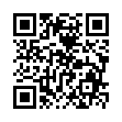
Don’t forget to connect, thanks for listening!
https://dataonwheels.wordpress.com/
kristyna@dataonwheels.com
@data_dragoness
GitHub

